Slide 1



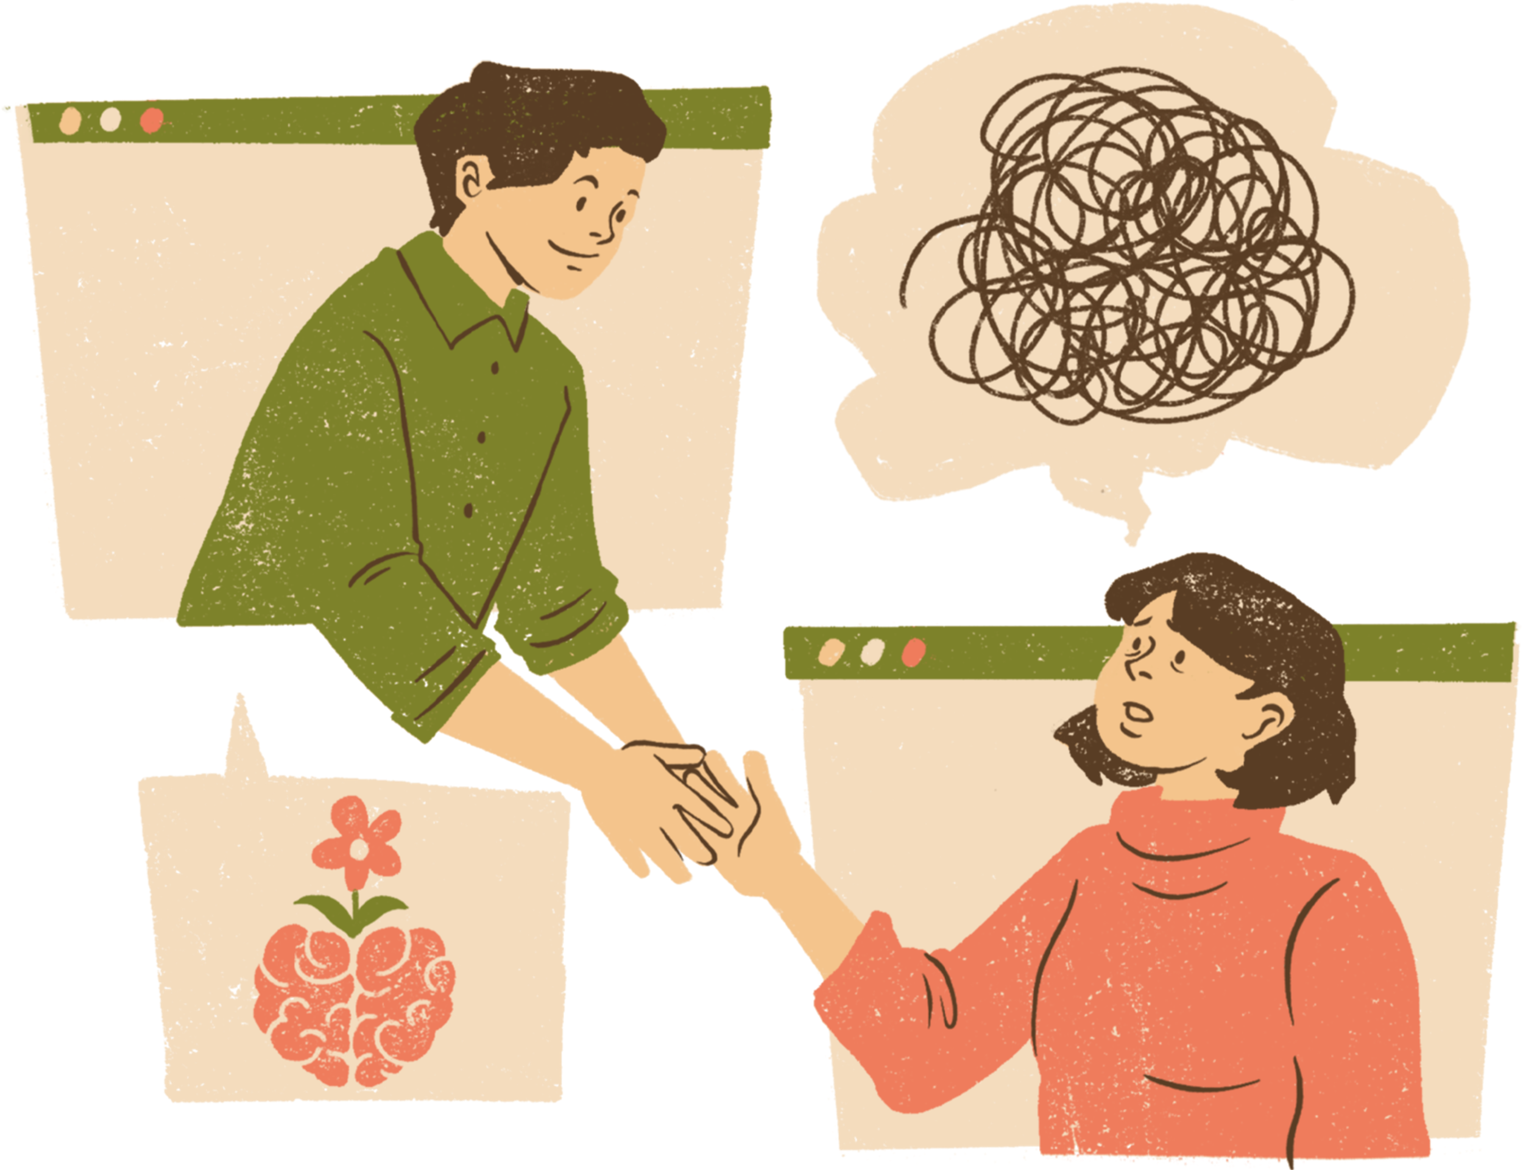


Thanking the World
Exploring Gender-Based Differences in Acknowledgment Patterns and Support Systems in Theses
Manika Lamba
Hendrik Erz
School of Information Science
Institute for Analytical Sociology
9th October 2023

Slide 2
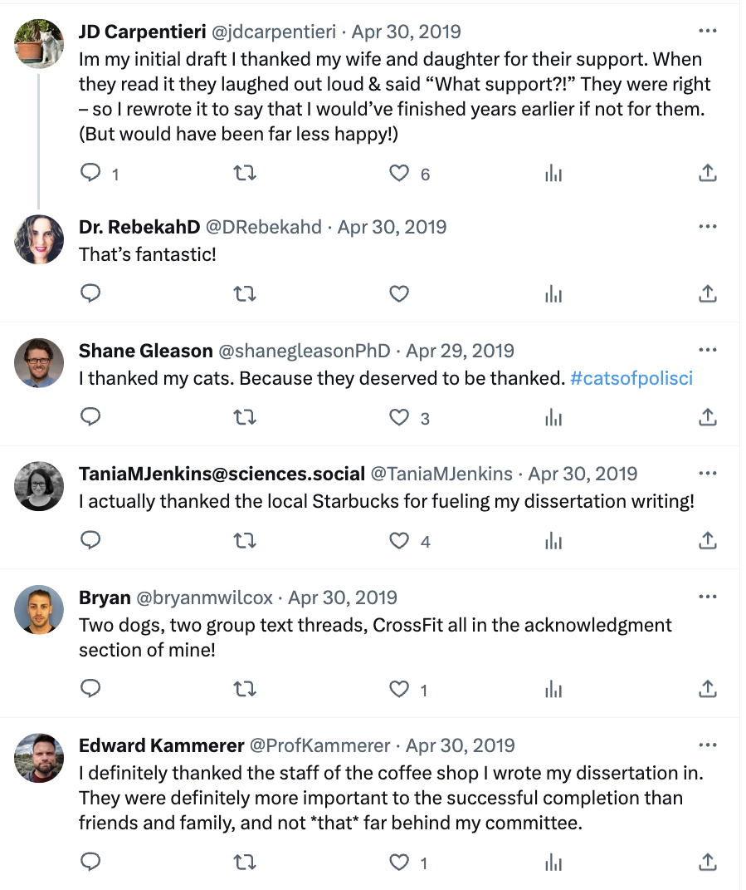
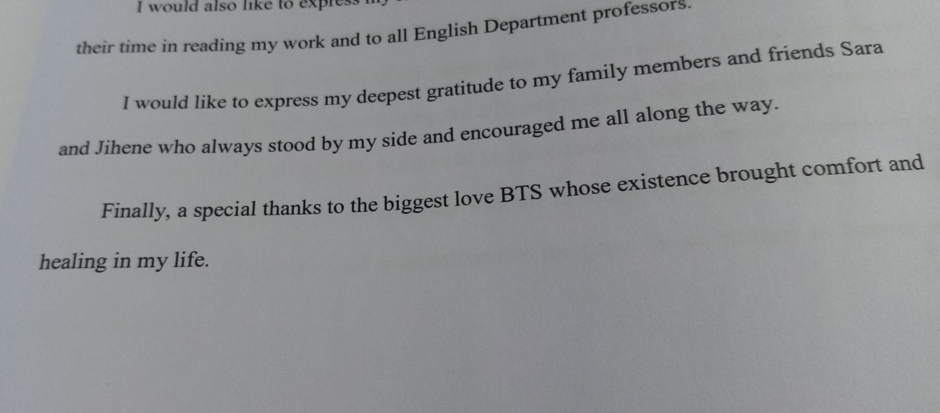
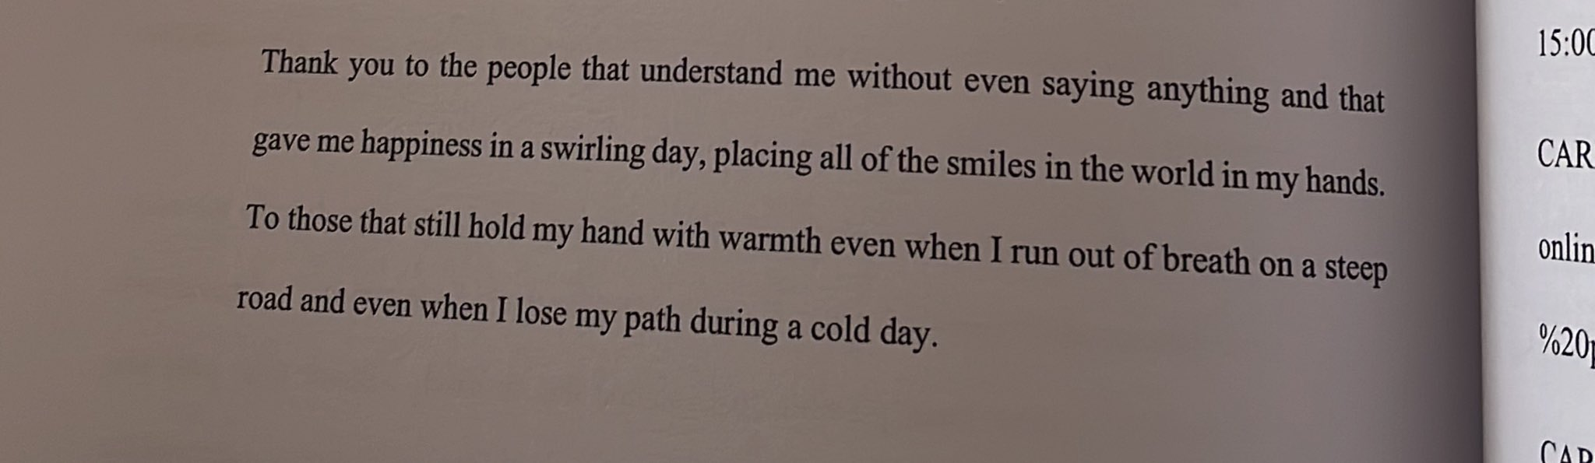

Slide 3

Introduction
Lots of research on acknowledgment sections of scientific papers since the 1990s
Lack of publications analyzing electronic theses and dissertations (ETD) acknowledgment sections (Bangani et al., 2020)
Cronin et al. (1992) identified positive correlation:
More Acknowledgments → More Citations in the future
Since 2008, WoS has been providing information on funding acknowledgments in WoS-indexed journals
Currently, there is no database that provides data on ETDs’ acknowledgments
We focus on the field of LIS as a case study
Bangani, S., Mashiyane, D., Makate, G., & Moyo, M. (2020). In/gratitude? Library acknowledgment in theses and dissertations at a distinguished African university. Library Philosophy and Practice, 3596
Cronin, B., McKenzie, G., & Stiffler, M. (1992). Patterns of Acknowledgment. Journal of Documentation, 48(1), 107–122. doi:10.1108/eb026893

Slide 4
Research Questions
RQ 1 What are the important support systems for male and female researchers to finish their master’s or doctoral research?
RQ2 What are the major sentiments that researchers felt throughout their journey of research?

Slide 5
Methodology

Slide 6
Data Extraction & Cleaning
Data
Text Extraction with Tesseract
Challenges in Acknowledgment Section Extraction
Initial Script Using Heuristics Extracted Only 1/3 of Theses
Varied Acknowledgment Styles Complicated Extraction
Manual Section Extraction
Due to Variances, Manual Extraction of Sections Required
Ensured Comprehensive Corpus Coverage
Corpus Refinement
Narrowed Corpus to Theses from 1960 to 2020
Excluded 1921-1959 Period Due to Data Limitations
Could not determine the gender of researchers and advisors in this period
Database: PQDT Global
Query: SU.exact("LIBRARY SCIENCE")
Period: 1921 to 2020
Language: English
No. of ETDs Downloaded (Manually b/w 2019-2021): 4000
No. of Acknowledgement Sections: 1252 or 20,834 individual sentences
4

Slide 7
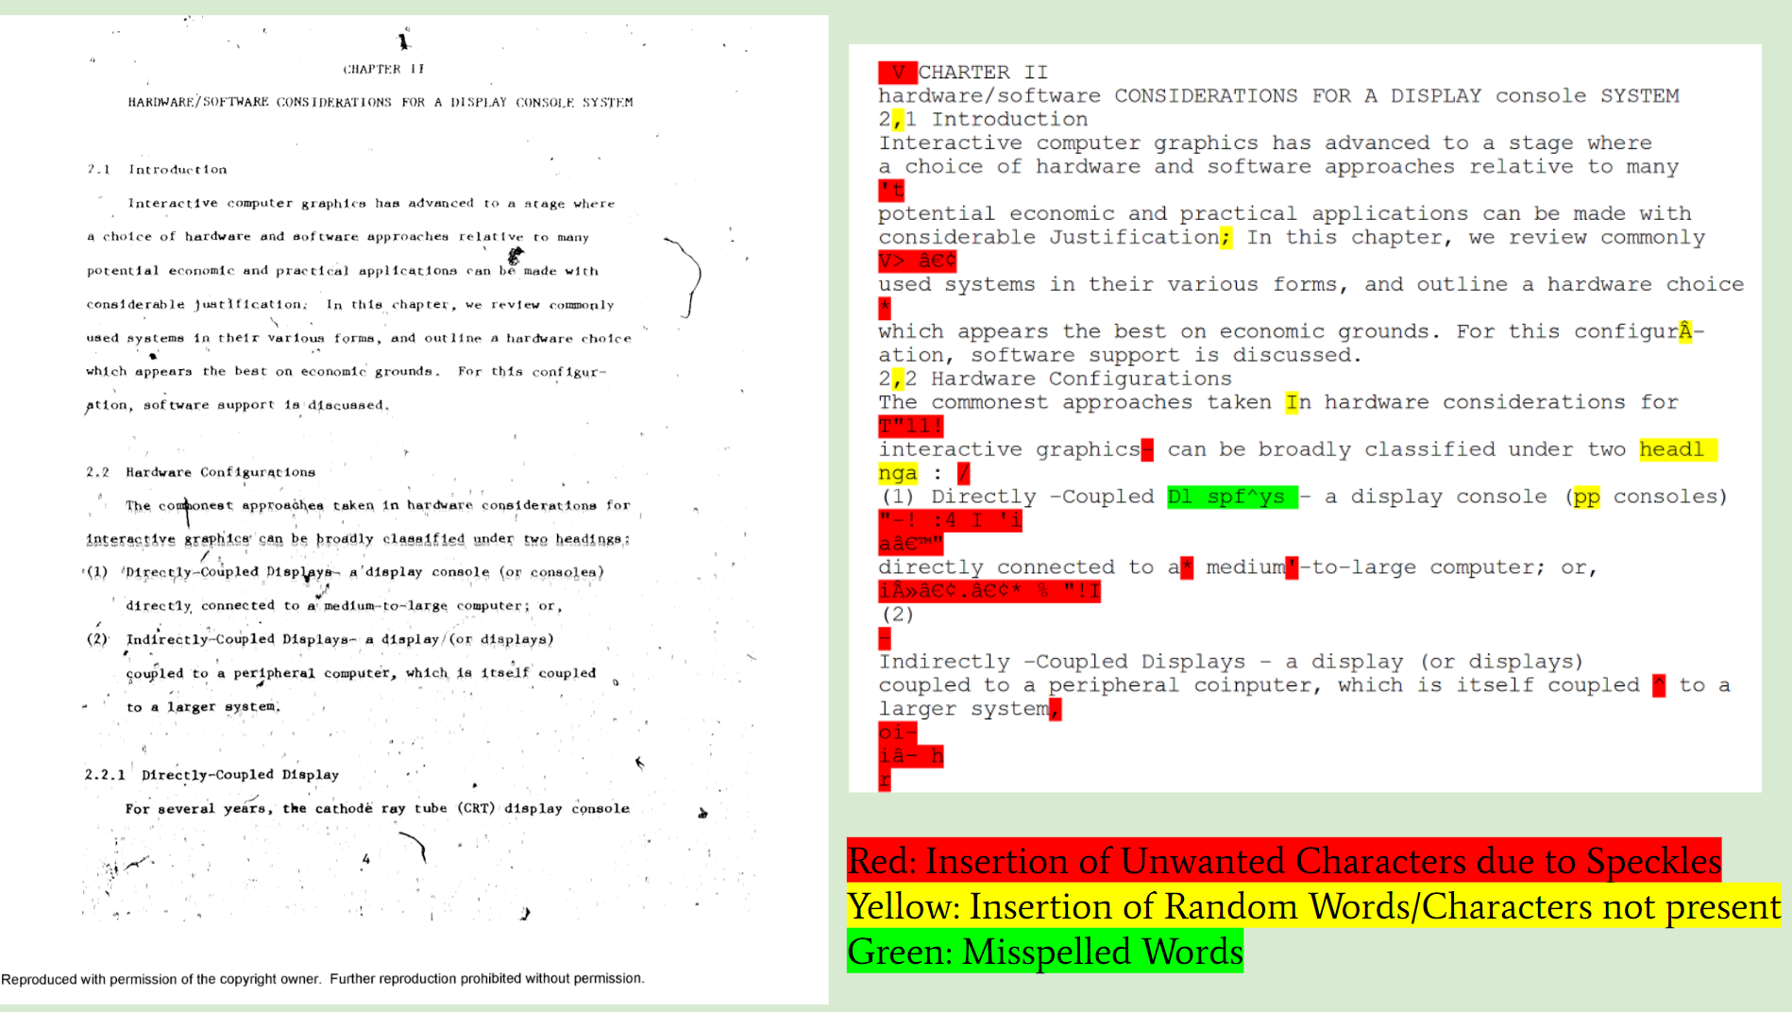
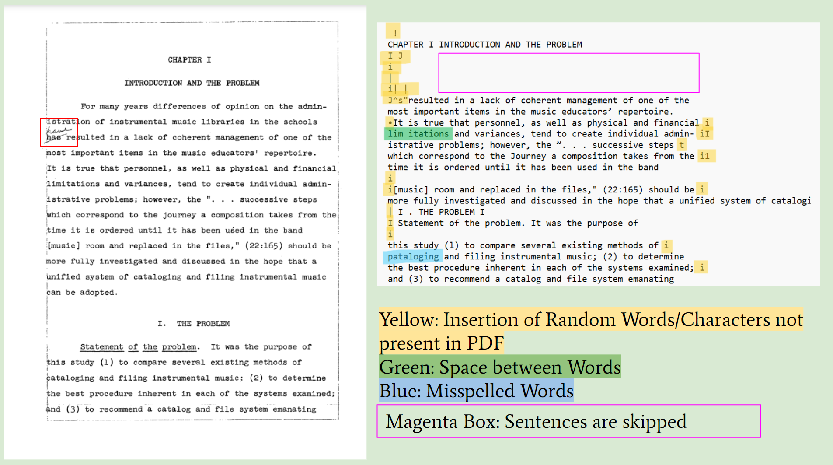
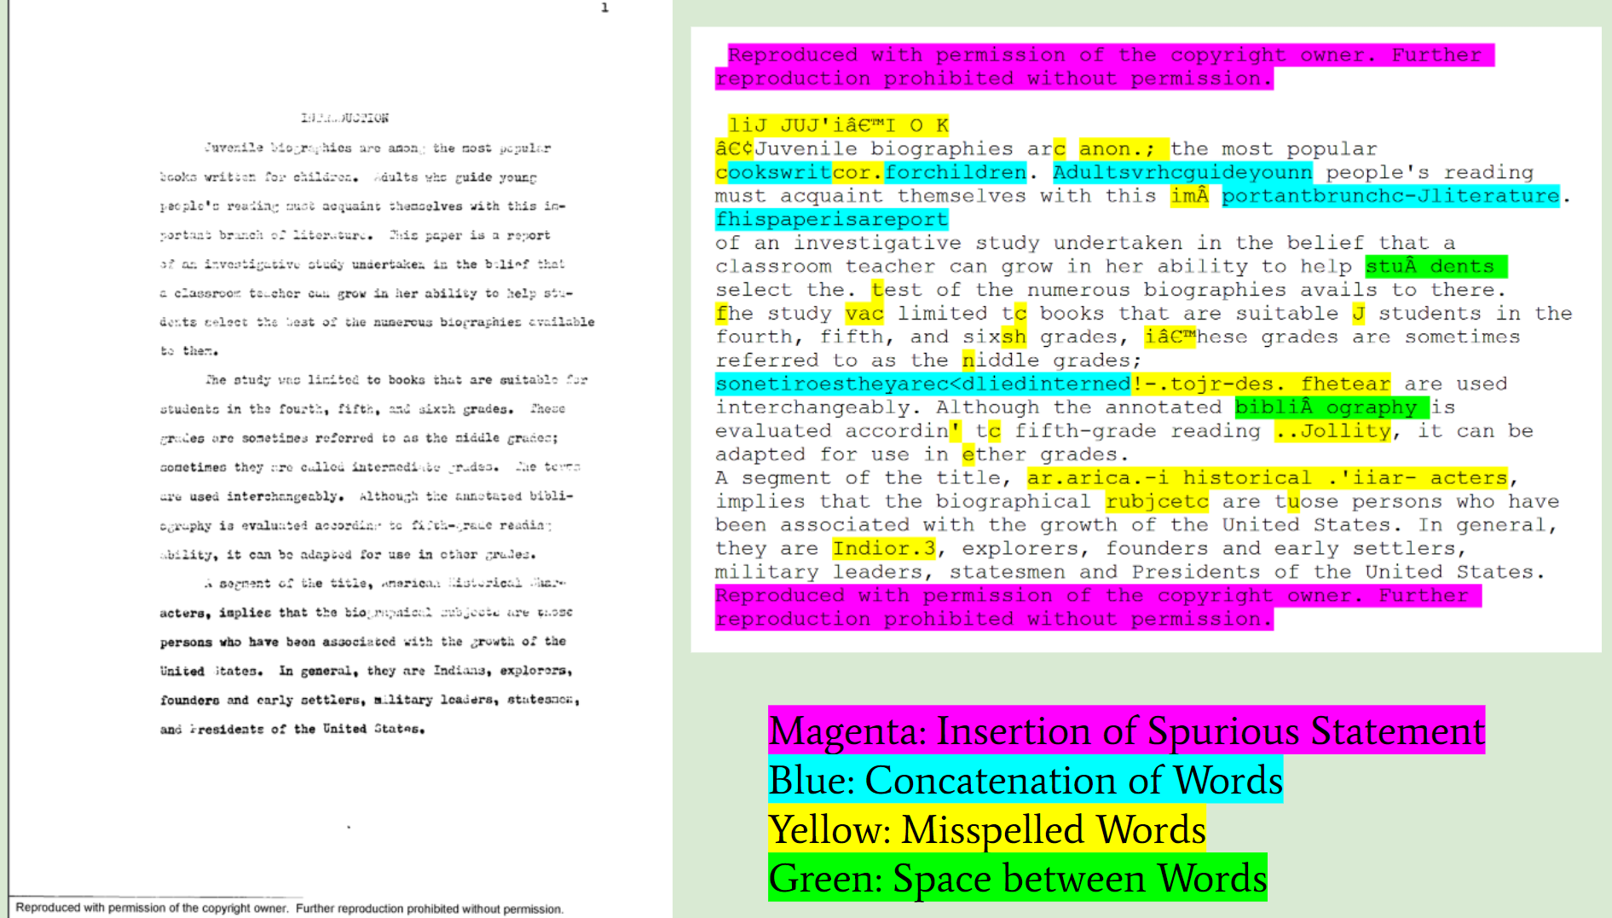
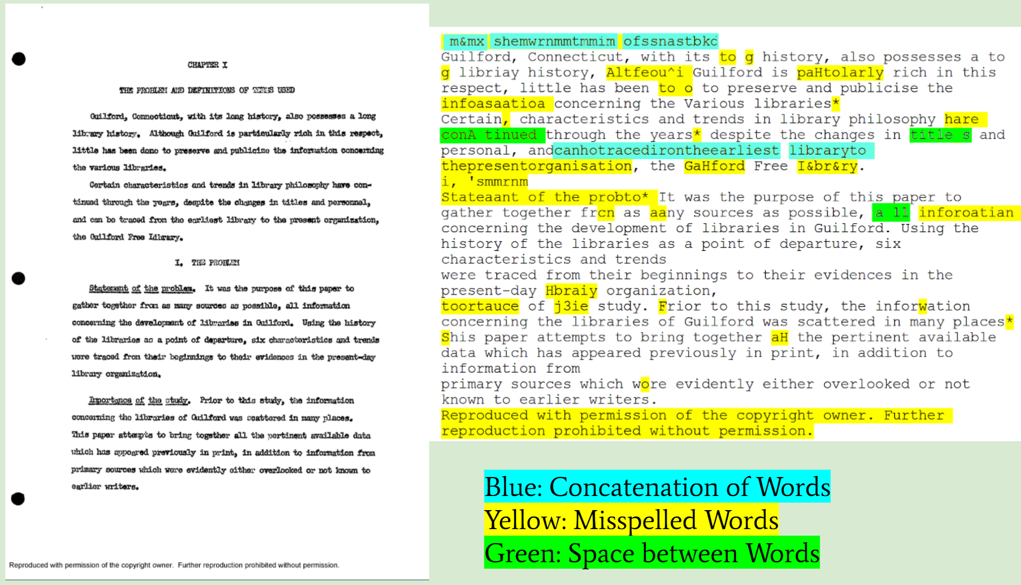
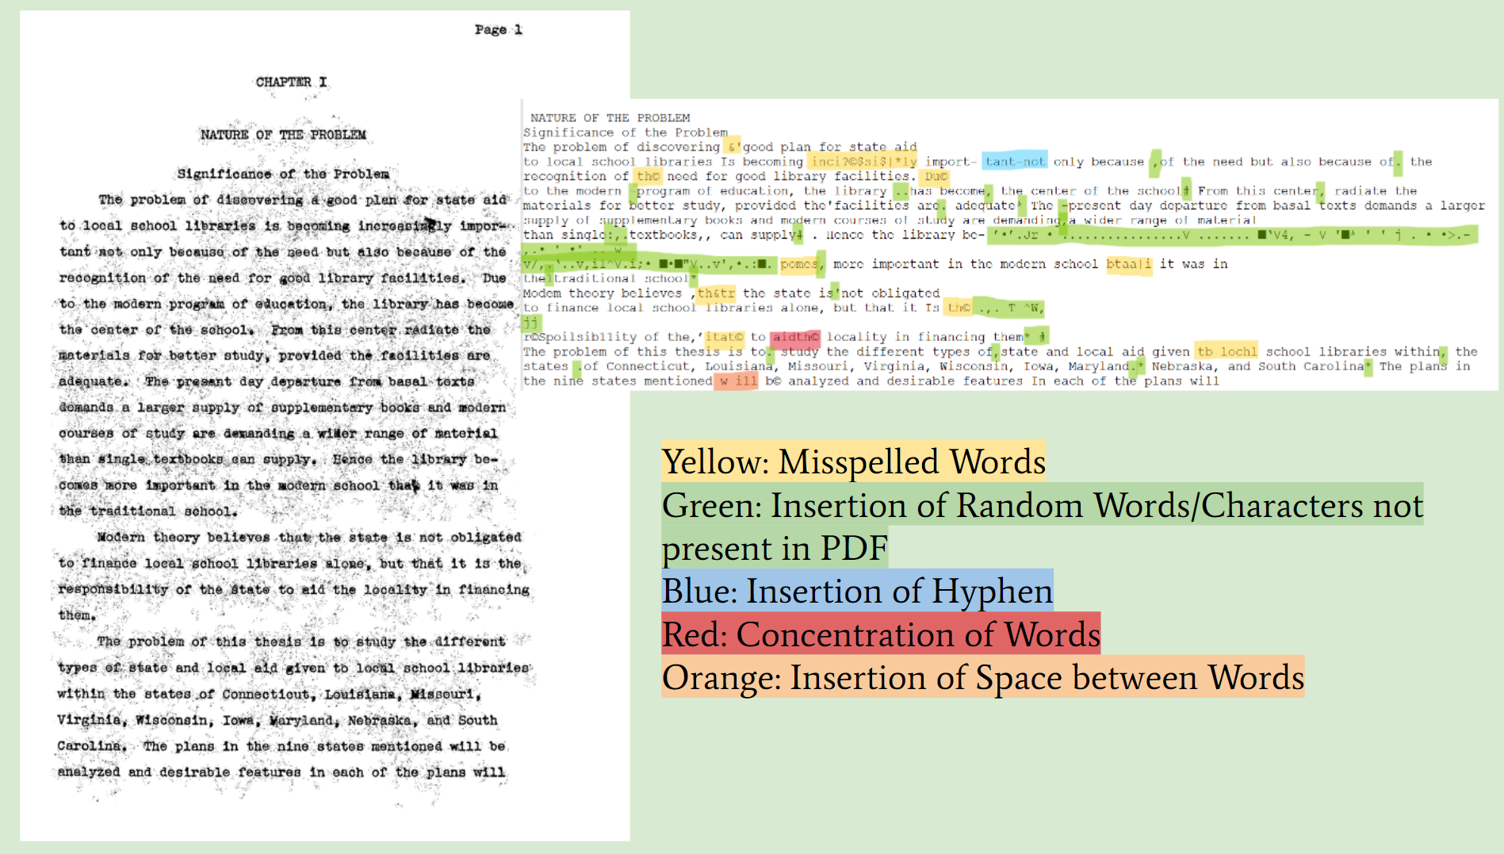
Lamba, M., & Madhusudhan, M. (2023). Exploring OCR Errors in Full-Text Large Documents: A Study of LIS Theses and Dissertations. Library Philosophy and Practice (e-Journal). https://digitalcommons.unl.edu/libphilprac/7824

Slide 8
Qualitative Coding

Slide 9
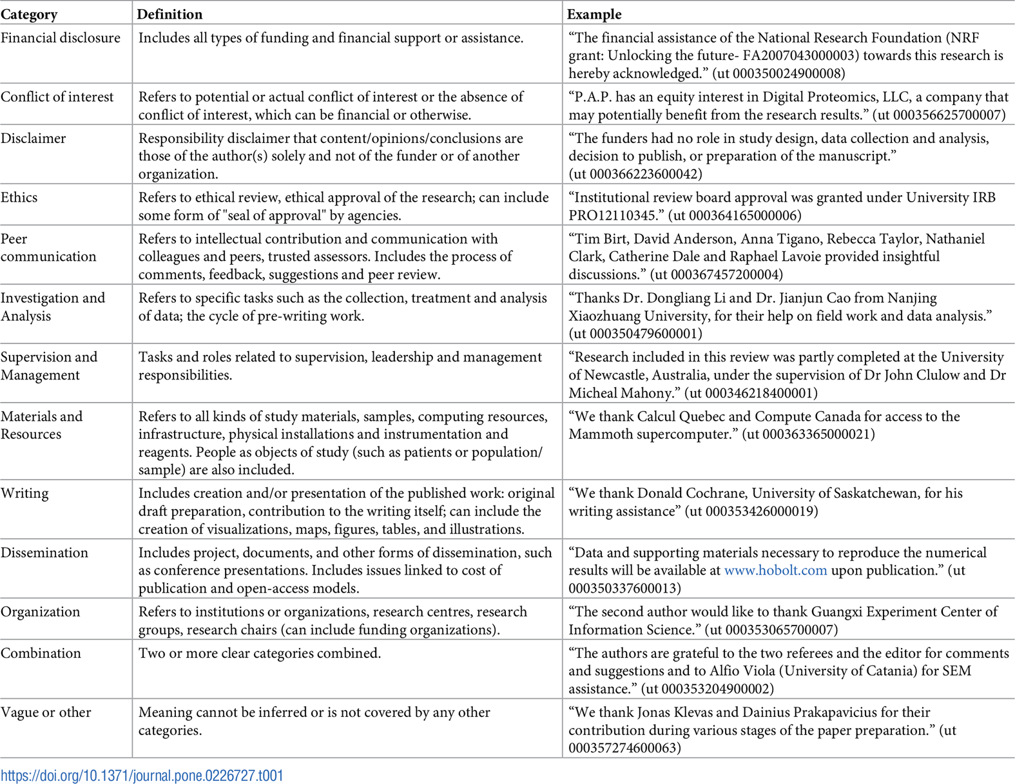
Paul-Hus and Desrochers (2019) used to classify research articles
Paul-Hus, N., & Desrochers, N. (2019). Acknowledgments are not just thank you notes: A qualitative analysis of acknowledgments content in scientific articles and reviews published in 2015. PLOS ONE, 14(5), e0226727. doi:10.1371/journal.pone.0226727

Slide 10
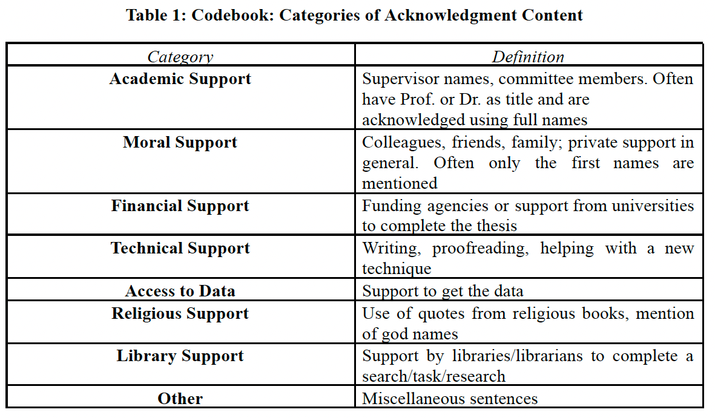
Qualitative Coding
Support Coding
Sentiment Coding
“very positive”, “somewhat positive”, or “neutral”
Creating a "Gold-Standard" Dataset
Sampled 903 Sentences from the Corpus
4 Coders Manually Labeled Support Type and Sentiment
Represented Approximately 4% of the Total Corpus
5

Slide 11
Automated Coding

Slide 12
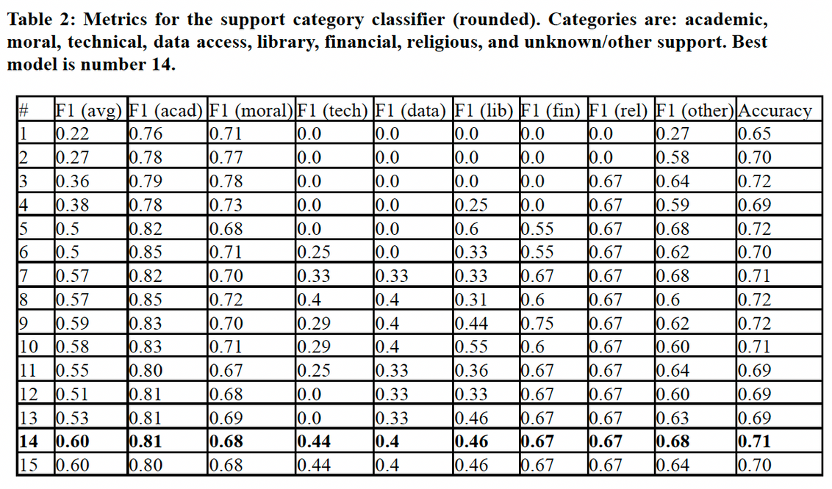
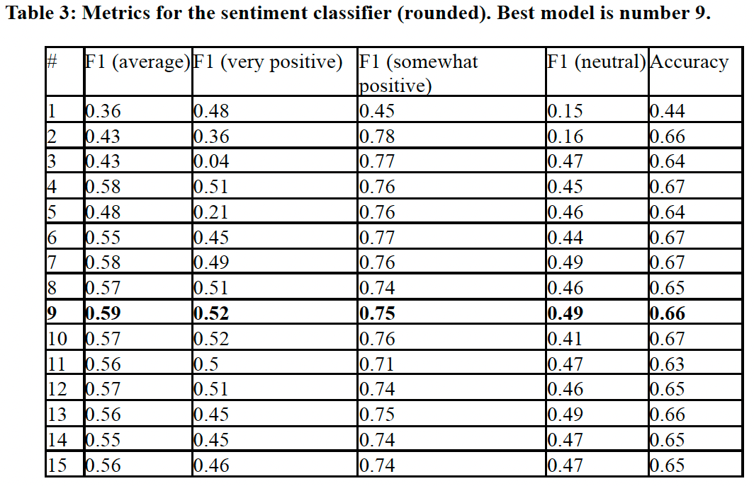
Automated Coding
Employed Large Language Model (LLM) for Classification
Applying Labeling Strategy to the Entire Corpus
Utilized a Sequence-Classification Task
Leveraged RoBERTa-base models (Liu et al., 2019) to Learn and Apply Human Annotations (Vaswani et al., 2017)
Liu, Y., Ott, M., Goyal, N., Du, J., Joshi, M., Chen, D., Levy, O., Lewis, M., Zettlemoyer, L., & Stoyanov, V. (2019). RoBERTa: A Robustly Optimized BERT Pretraining Approach. arXiv:1907.11692 [Cs]. http://arxiv.org/abs/1907.11692
Vaswani, N., Shazeer, N., Parmar, J., Uszkoreit, L., Jones, L., Gomez, A. N., ... Polo-sukhin, I. (2017). Attention Is All You Need. arXiv:1706.03762 [cs]. arXiv:1706.03762
6

Slide 13
Gender Analysis
Gender determination for supervisors and authors which did match almost all names
Utilized a list of commonly female & male given names from the corresponding data files that can be found at https://www.geeksforgeeks.org/python-gender-identification-by-name-using-nltk/
The gendered nouns ("he", "she", etc.) have been collected from the data files "male_pairs.txt" and "female_pairs.txt" from this github repository: https://github.Com/nikhgarg/embeddingdynamicstereotypes/tree/master/data
Enhancing our understanding of gender-based discrepancies
7

Slide 14
Findings

Slide 15
Sentiment Analysis
Sentiment Distribution
Most Sentences: "Neutral" Sentiment
Followed by "Somewhat Positive"
Lastly, "Very Positive"
Formalized Acknowledgment Style
Limited Sentiment Variation
Suggests a Consistent, Formalized Style
Allows for Academic Expression with Emotional Tone
8

Slide 16
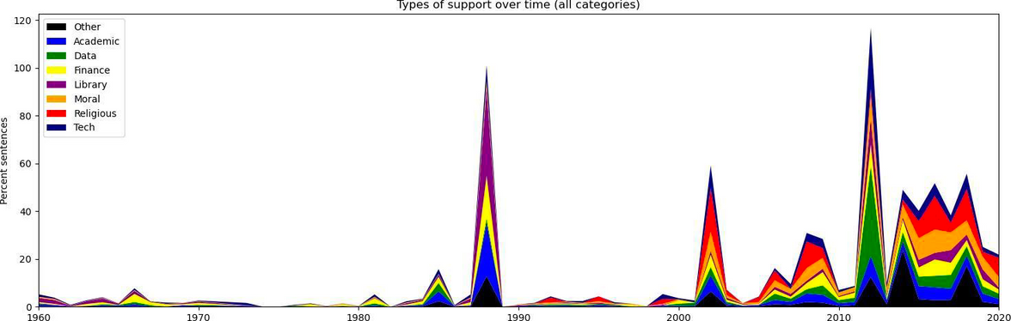
Support Systems
Most Frequent Support Categories
Academic Support: 26.72%
Moral Support: 11.22%
Library Support: 3.40%
Emerging Trend: Religious Support
Historically Insignificant
Increasing Frequency in the 21st Century
Notable shift in acknowledgment patterns
Diversity in Support Systems
"Other" Category Dominant: 53.93%
Support Systems are more diverse than expected
Fig: Evolution of the acknowledgment of various types of support systems over time (1960-2020)
9

Slide 17
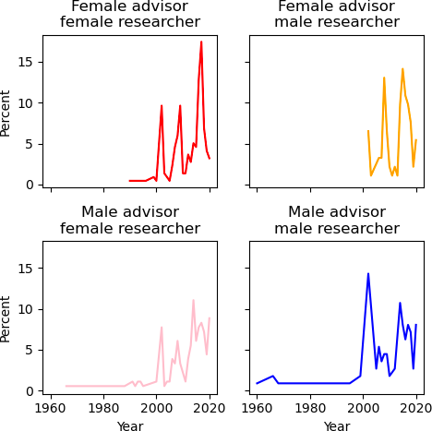
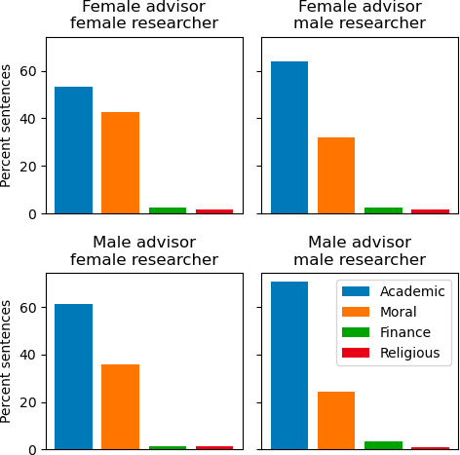
Gender Analysis
After omitting researcher-advisor pairs where any participants’ gender could not be determined, we were left with 603 pairs
Gender Distribution
Advisors' Gender Balance:
Female: 51%
Male: 49%
Researcher Predominance:
Female Researchers: 66%
Male Researchers: 34%
(a) Breakdown of advisor-researcher pair proportions over time (1960-2020)
(b) Breakdown of advisor-researcher pair proportions by type of support (1927-2020)
Figure 2: Analysis of acknowledgment sections by gender, broken into the four combinations of female-female, female-male, male-female, and male-male
10

Slide 18
Gender Analysis
Regardless of Gender, Advisors Prefer Same-Gender Researchers (Fig. 2a).
Female researchers tended to acknowledge both their family/friends and supervisors/committee members more frequently than male researchers in their theses
Female researchers acknowledge their academic support system more than their moral support system (60% versus 40%) when they are supervised by a male advisor as opposed to when they are supervised by a female advisor (50% versus 40%) (Fig. 2b)
Male researchers acknowledge their moral support system more when they are supervised by a female supervisor (60% versus 30%) as opposed to when they are supervised by a male supervisor (70% versus 20%) (Fig. 2b)
Religious Support:
Male vs. Female Supervisor: No strong gender-based differences
Financial Support:
Male Researchers Supervised by Male Advisors:
More frequent acknowledgment of financial support
Understanding these gender-based differences in acknowledgment patterns provides insights into the complex dynamics of support systems and the unique challenges faced by researchers of different genders
11
Notes:
- Our analysis reveals .........(Fig 2a)
This finding raises important questions about gender disparities in research supervision within the field of LIS. It highlights the need for further investigation and intervention to ensure equitable support and opportunities for all researchers
- We found......(Fig 2b)
This suggests that female researchers may rely on a broader support network encompassing both personal and academic spheres.

Slide 19


Analysis of acknowledgment sections relies on the accuracy of the data extraction process, which may be subject to errors, particularly in cases of OCR inaccuracies
Focus on the field of LIS may limit the generalizability of the findings to other academic disciplines
Limitations
1
2
Even though the metrics for our classifier show strong support for our interpretations, better results might be obtained by annotating more examples, e.g., via utilizing Active Learning
There might be errors during the assignment of gender to the advisors’ and researchers’ names
3
4
13

Slide 20
Tracking Language Evolution Over Time
Study the evolution of language in acknowledgment sections over the years
Analyze shifts in expressions of gratitude and recognition
Uncover linguistic trends and changes in academic writing
Exploring Linguistic Discourse and Potential Biases
Investigate adjectives used when acknowledging female vs. male supervisors
Analyze whether certain adjectives exhibit gender-associated patterns
Examine potential biases in expressions of gratitude
Future Directions
1
2
Discerning Variations Across Disciplines and Languages
Explore variations in acknowledgments across diverse academic fields
Analyze differences in language use in acknowledgment sections in various languages
Correlation with Academic Achievements
Investigate the connection between acknowledgment section vocabulary and academic success
Identify specific vocabularies linked to subsequent citation recognition
3
4
14

Slide 21
CONCLUSION
Qualitative and quantitative analysis of expressions in ETD acknowledgment sections
Insights into types of acknowledged support
Identifying distinctions in support networks between male and female researchers
Highlighting varied emphases on different forms of support
Providing a corpus of annotated sentences from ETDs
Facilitating research in Natural Language Processing (NLP)
Empowering researchers to employ NLP methods
Exemplifying the creation of similar datasets for diverse academic fields

Slide 22
Thank You

